Slide 1
Job Market Trends and forecasting
Data Analysisi, insights & predictive modeling
Meet patel
Date: 28/05/2025

Slide 2
Objectives of the Analysis:
Understand trends and patterns in the job market using recent job postings.
Analyze relationships between job titles, salaries, geography, and remote work.
Forecast future trends to support workforce planning and career decisions.
Build tools like recommendation engines and interactive dashboards.
Dataset Used:
Source: Aggregated job postings
Time Range: February to March 2024
Key columns:
Title : job title
Publish date: date of posting
Country: job location
hourly_low , hourly_high,budget : Compensation details
Tools & Libraries:
Python: Data processing and scripting
pandas: Data manipulation
seaborn, matplotlib: Data visualization
Prophet: Time-series forecasting
scikit-learn: Machine learning & vectorization
Streamlit : Web dashboards & APIs

Slide 3
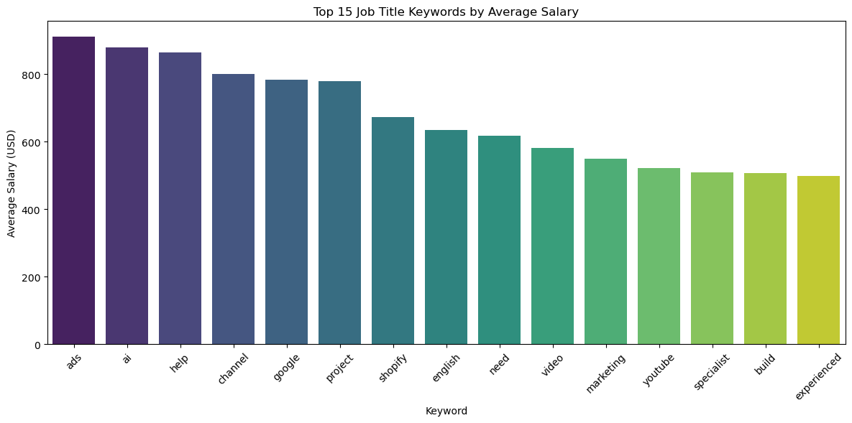
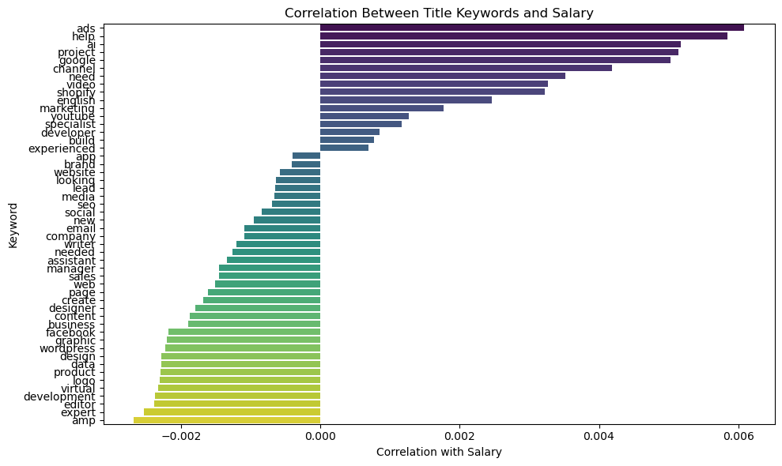
Salary Normalization :
Hour based : 102422 out of 206313
Budget based:103891 out of 206313
Keyword extraction :
First, clean and lowercase job titles.
Apply countvectorizer to extract top
15 key words.
Correlation analysis:

Slide 4
Emerging Job Categories:
Extract keywords from job titles using CountVectorizer.
Aggregate job counts per keyword by year_month.
Calculate monthly posting trends for each keyword.
Use growth rate to identify emerging roles.

Slide 5
Hourly Rate by Country:
Group job postings by country.
Calculate average hourly_low and hourly_high rates.
Handle missing values and normalize rates.
Use aggregation functions to get country-wise averages.

Slide 6
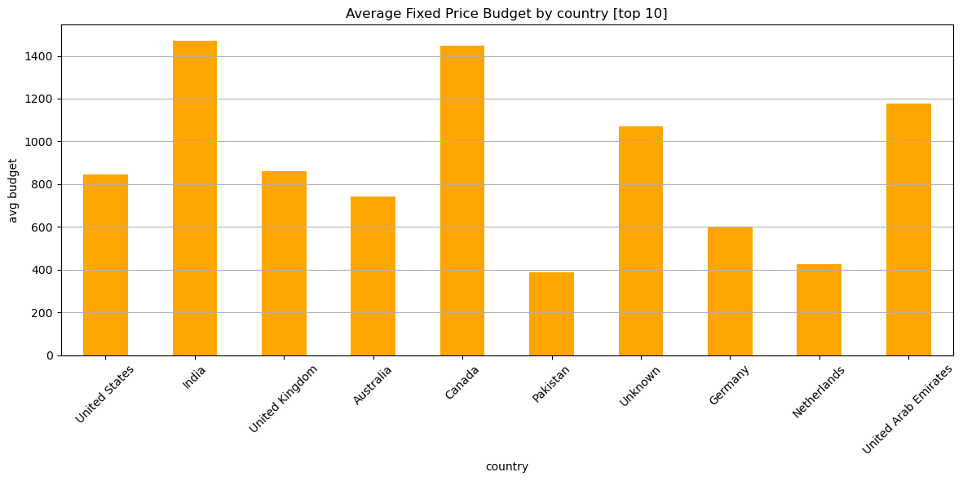
India has the highest average budget (~1,470).
Canada (~1,440) and UAE (~1,180) also show strong average budgets.
"Unknown" category is also high (~1,070), indicating anonymized or missing location data linked to higher budgets.
Pakistan (~380) and Netherlands (~420) have the lowest average budgets among the top 10.
Germany is mid-range (~600).

Slide 7
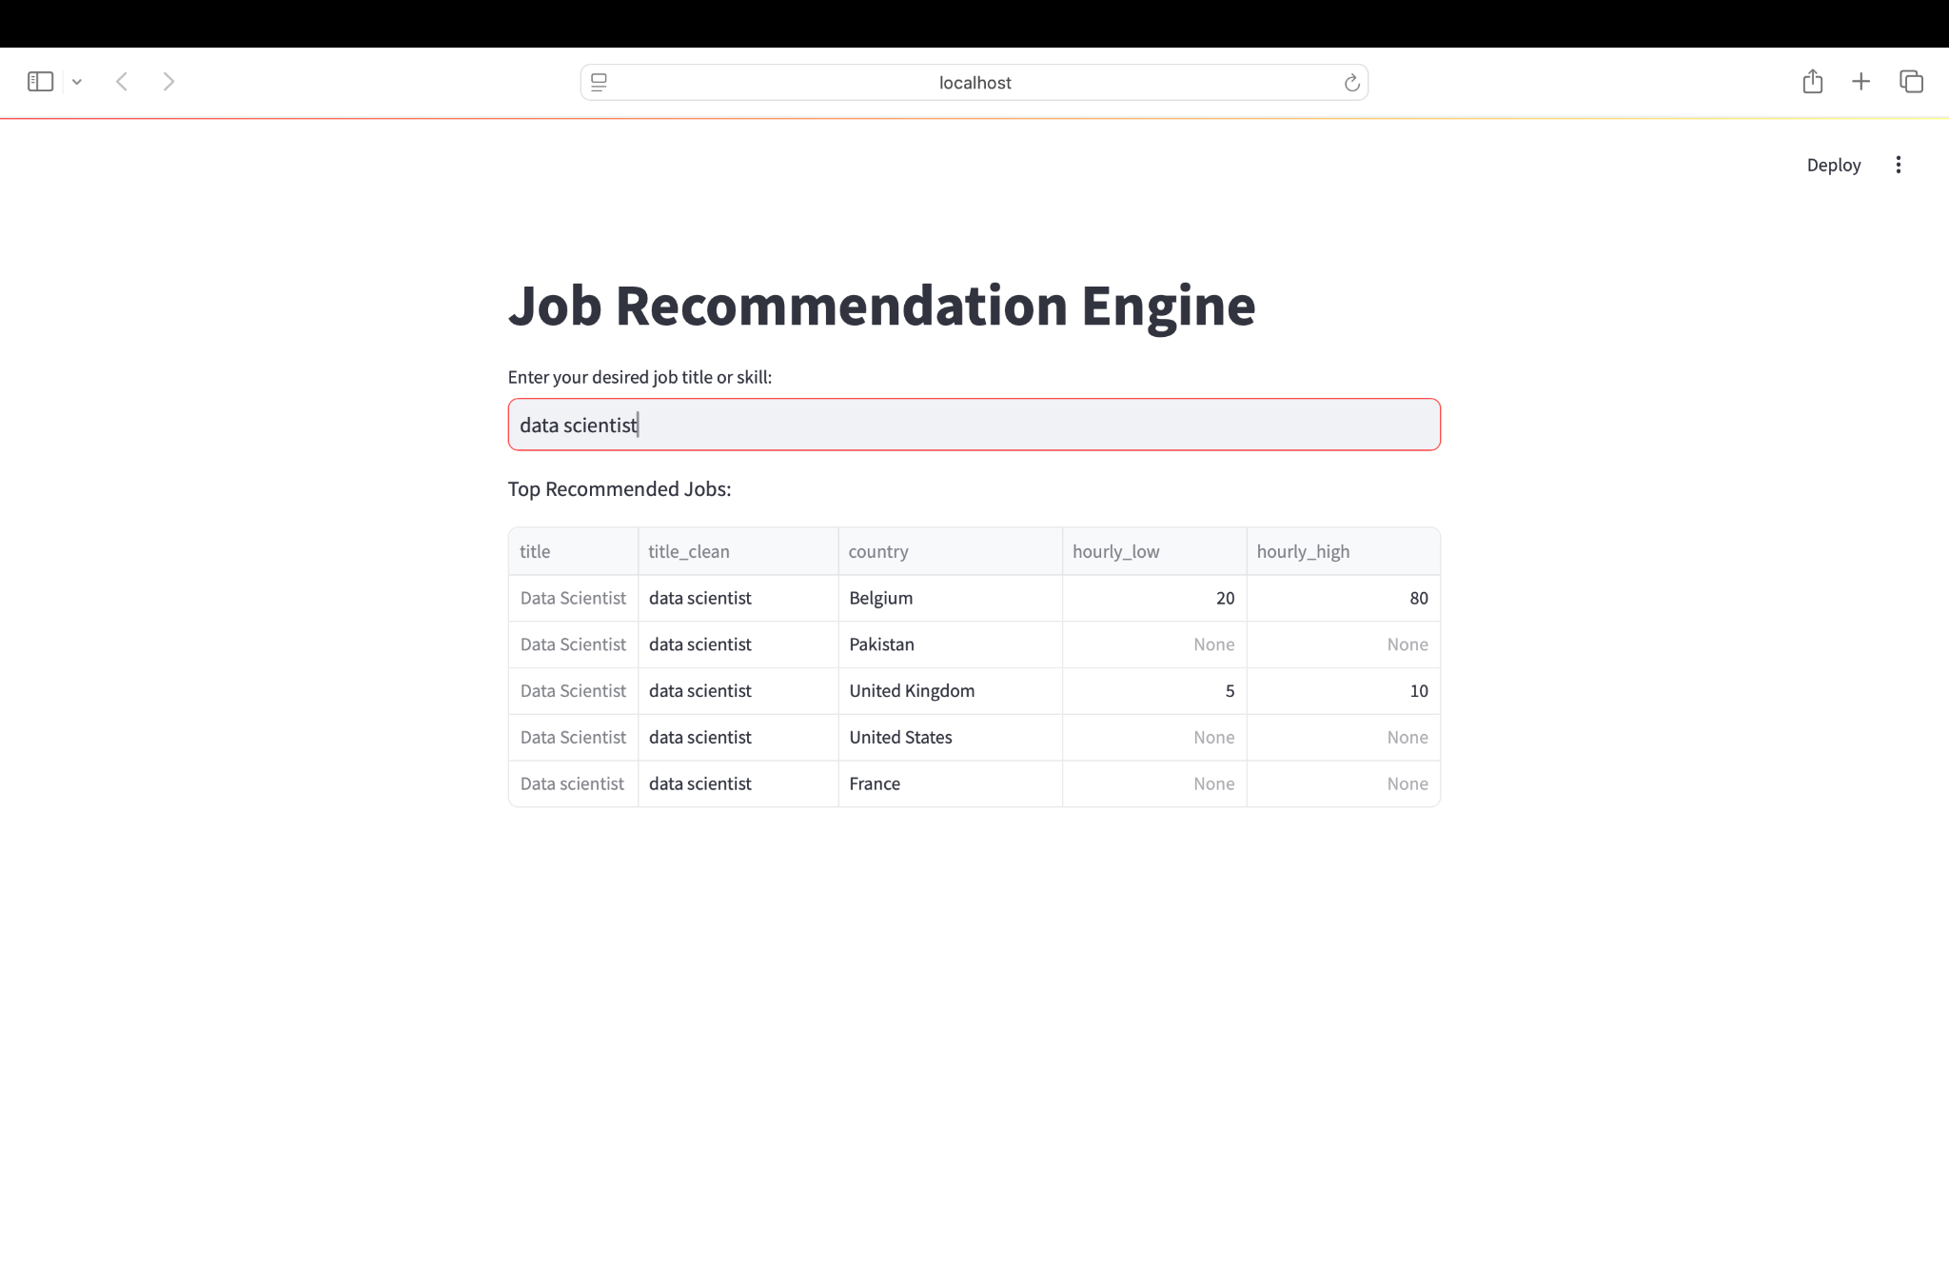
Job Recommendation Engine:

Slide 8
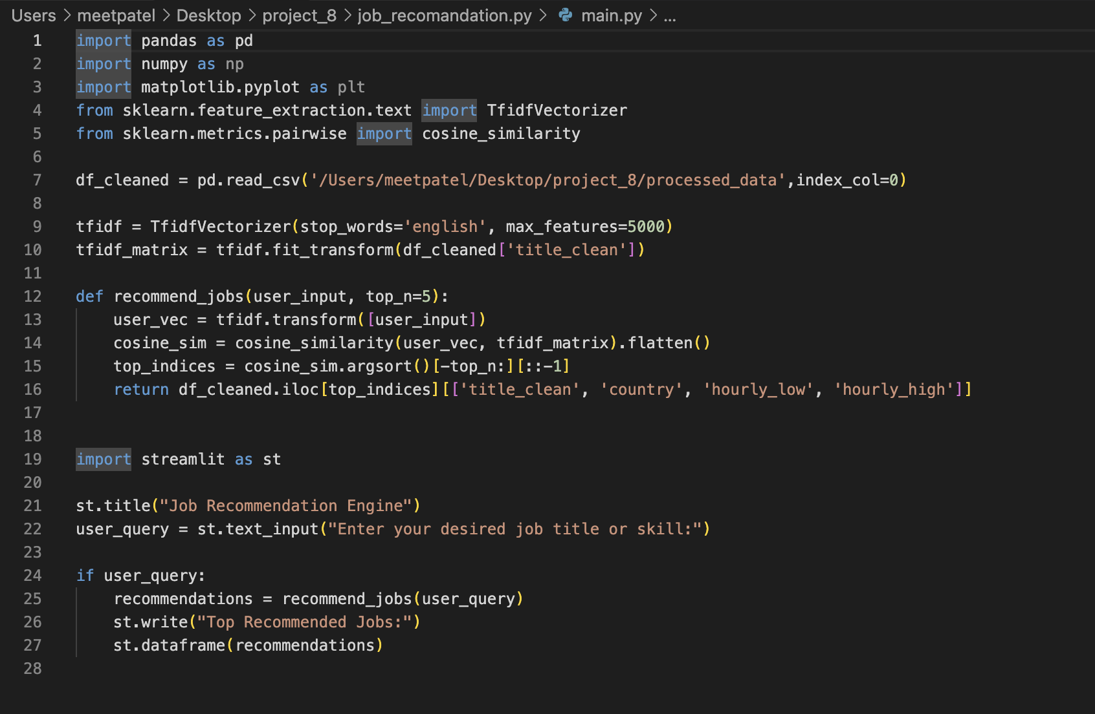
Code of job recommendation engine:

Slide 9
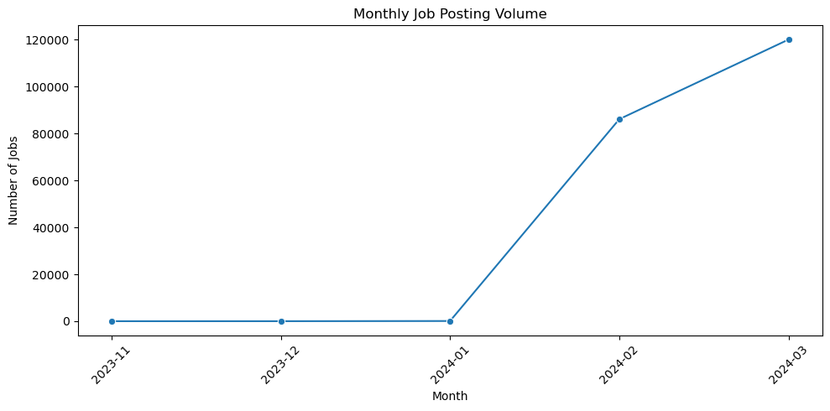
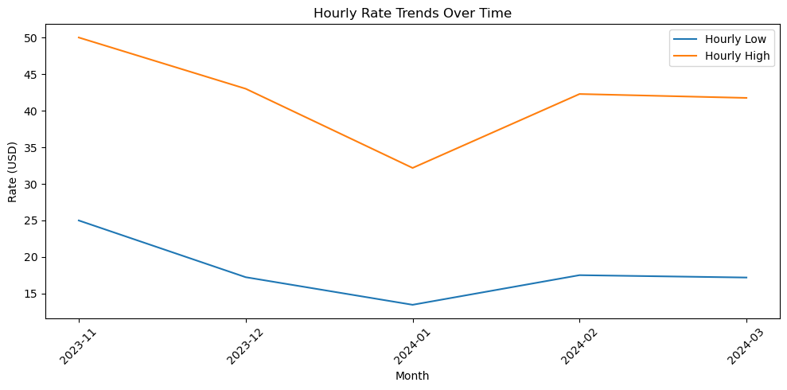
Market Dynamics Tracking:

Slide 10
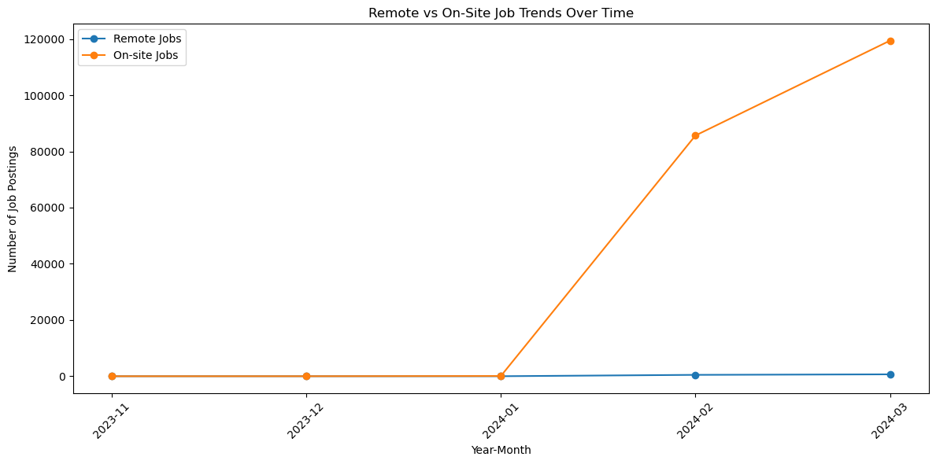
Remote Work Trends:
Remote jobs have remained relatively low and stable, with counts in the hundreds to low thousands.
On-site jobs show an explosive growth from 0 to ~120,000 between January and March 2024.
The scale difference between the two makes the remote trend appear flat by comparison, though it's not necessarily stagnant.

Slide 11
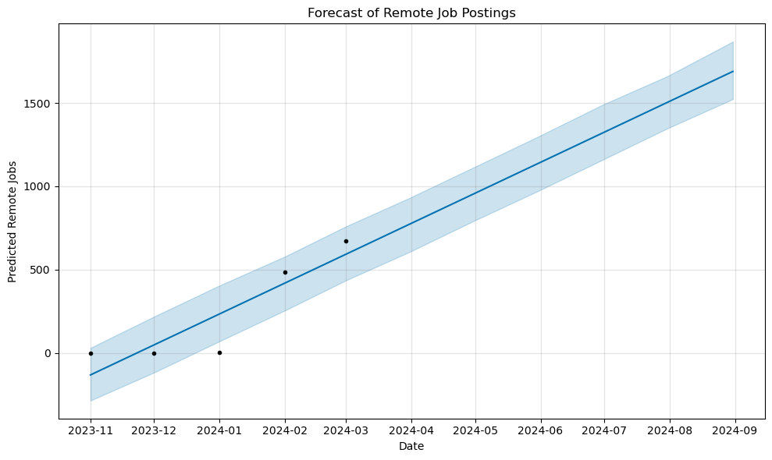
The trend indicates a steady increase in remote job postings from early 2024 through mid to late 2024.
The confidence interval widens over time, which is common in forecasts to reflect growing uncertainty.
Actual data points (black dots) in early 2024 seem to align closely with the forecast, suggesting a good model fit up to that point.

Slide 12
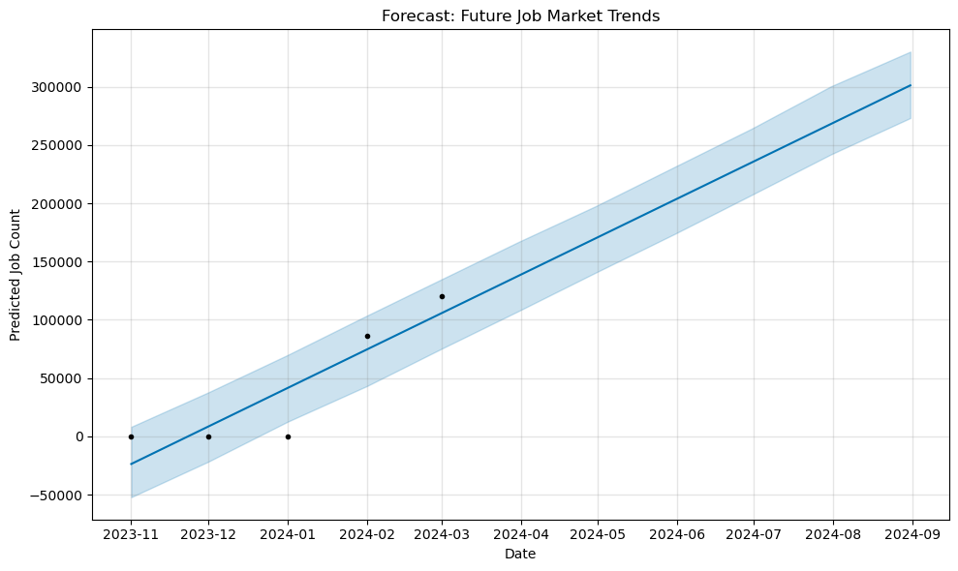
There is a strong upward trend in predicted job market growth through mid and late 2024.
The initial observed values (dots before 2024-04) align reasonably well with the forecast.
The scale of this chart (up to 300,000) suggests it's modeling the broader job market, in contrast to your previous chart which focused specifically on remote job postings (max 1700)

Slide 13
THANK YOU

